Slide 1
Welcome to Quiz 4

Slide 2
Your Challenge
In this Quiz there are 8 rounds based on 8 former, or present day, quiz shows. Your task is to build up a bank of points in the first 7 rounds and then gamble those points in Round 8.
Your Target is to try to get more than 10,000 points.
Good Luck.

Slide 3
Celebrating TV Quiz Shows
A Question of Sport
University Challenge
Sale of the Century
Double your Money
Take Your Pick
Generation Game
Pointless
Winner Takes All

Slide 4
A Question of Sport 2nd December 1968 – present day

Slide 5
Round 1
Your job is to note the 20 previous Ladies Champions at Wimbledon and, if you recognise the lady, to get a bonus by noting their country.
Your target at the end of this round is 300 points

Slide 6
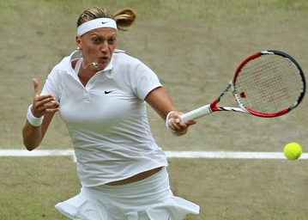
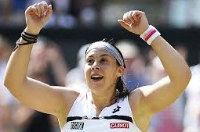
Question of Sport Wimbledon Ladies Singles Champions 10 pts per competitor (Bonus 10 pts for their country)
1 (2014) | 2 (2013)

Slide 7
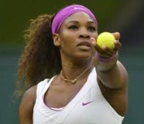
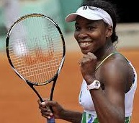
Question of Sport Wimbledon Ladies Singles Champions 10 pts per competitor (Bonus 10 pts for Country)
3 (2012) | 4 (2008)

Slide 8
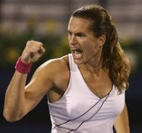
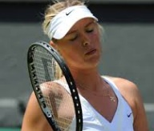
Question of Sport Wimbledon Ladies Singles Champions 10 pts per competitor (Bonus 10 pts for Country)
5 (2006) | 6 (2004)

Slide 9
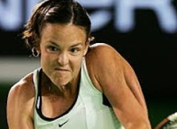
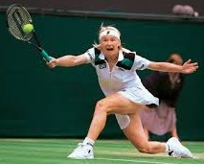
Question of Sport Wimbledon Ladies Singles Champions 10 pts per competitor (Bonus 10 pts for Country)
7 (1999) | 8 (1998)

Slide 10
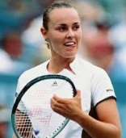
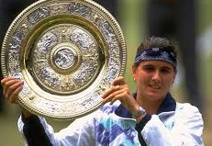
Question of Sport Wimbledon Ladies Singles Champions 10 pts per competitor (Bonus 10 pts for Country)
9 (1997) | 10 (1996)

Slide 11
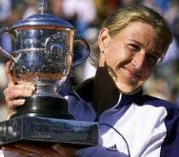
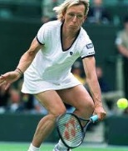
Question of Sport Wimbledon Ladies Singles Champions 10 pts per competitor (Bonus 10 pts for Country)
11 (1994) | 12 (1990)

Slide 12
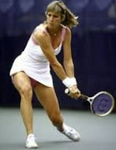
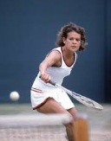
Question of Sport Wimbledon Ladies Singles Champions 10 pts per competitor (Bonus 10 pts for Country)
13 (1981) | 14 (1980)

Slide 13
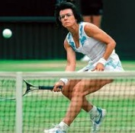
Question of Sport Wimbledon Ladies Singles Champions 10 pts per competitor (Bonus 10 pts for Country)
15 (1977) | 16 (1975)

Slide 14
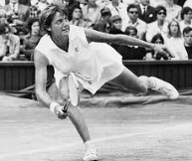
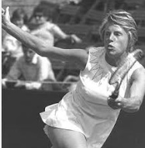
Question of Sport Wimbledon Ladies Singles Champions 10 pts per competitor (Bonus 10 pts for Country)
17 (1970) | 18 (1969)

Slide 15
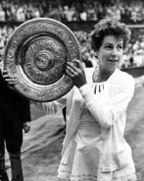
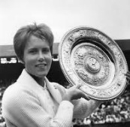
Question of Sport Wimbledon Ladies Singles Champions 10 pts per competitor (Bonus 10 pts for Country)
19 (1964) | 20 (1962)

Slide 16
Final check on your answers
Have you noted your answers to all 20 former Champions, and have you tried for a bonus by noting the countries of the ones you recognise?

Slide 17
10 pts per competitor + 10 pts per country
1 | Petra Kvitova | Czech Rep. | 11 | Steffi Graff | Germany
2 | Marion Bartoli | France | 12 | Martina Navratilova | USA
3 | Serena Williams | USA | 13 | Chris Evert | USA
4 | Venus Williams | USA | 14 | Evonne Goolagong | Australia
5 | Amelie Mauresmo | France | 15 | Virginia Wade | GB
6 | Maria Sharapova | Russia | 16 | Billie Jean King | USA
7 | Lindsay Davenport | USA | 17 | Margaret Court | Australia
8 | Jana Novotna | Czech Rep. | 18 | Ann Jones | GB
9 | Martina Hingis | Switz. | 19 | Maria Bueno | Brazil
10 | Conchita Martinez | Spain | 20 | Karen Susman | USA

Slide 18
Target
How did you do?
The target was 300 points.
Did you surpass the target?

Slide 19
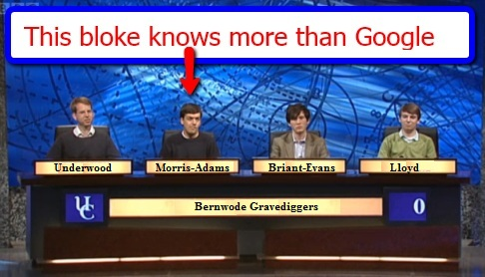
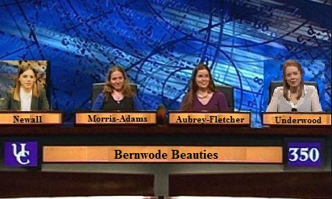
University Challenge 1962-1987 & 1994- present

Slide 20
University Challenge Which of these places are to the West of Chilton (Bucks) (1.008W)? 30 pts per correct answer; TOTAL SCORE OF ZERO on this round for even one incorrect answer.
AYLESBURY | NOTTINGHAM
BOURNEMOUTH | OXFORD
BRILL | READING
BUCKINGHAM | RUGBY
EDINBURGH | SHEFFIELD
JOHN O’GROATS | SUNDERLAND
LEEDS | THAME
LEICESTER | TOWCESTER
LONG CRENDON | WINCHESTER
NEWBURY | YORK

Slide 21
Target
In this round you must only record which of the 20 places you believe to be West of Chilton. If you get one wrong you score ZERO on the whole round.
I think you will get 12 correct and avoid all of the wrong answers. This would give you a score of 360.
So your Target after 2 Rounds is 660 pts

Slide 22
Map showing the position of Chilton

Slide 23
University Challenge Which of these places are to the West of Chilton (1.008 W)? 30 pts per correct answer; TOTAL SCORE OF ZERO on this round for even one incorrect answer.
AYLESBURY 0.82 W | NOTTINGHAM 1.08 W
BOURNEMOUTH 1.52 W | OXFORD 1.15 W
BRILL 1.052 W | READING 0.58 W
BUCKINGHAM 0.986 W | RUGBY 1.26 W
EDINBURGH 3.11 W | SHEFFIELD 1.28 W
JOHN O’GROATS 3.07 W | SUNDERLAND 1.38 W
LEEDS 1.32 W | THAME 0.97 W
LEICESTER 1.8 W | TOWCESTER 0.99 W
LONG CRENDON 0.997 W | WINCHESTER 1.31 W
NEWBURY 1.32 W | YORK 1.4 W

Slide 24
How did you do?
Did you avoid all of the RED ones?
What did you score?
Are you meeting the target of 660 points?

Slide 25
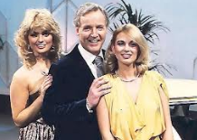
Sale of the Century 1972 - 1983

Slide 26
Sale of the Century
Winners share 2400 pts
4th Round losers 300 pts
3rd Round losers 200 pts
2nd Round losers 100 pts
First Round losers 50 pts

Slide 27
John Lewis
All items are taken from the current John Lewis catalogue.
They are items that are used from daybreak to nightfall.
You have a choice of 3 prices each round.

Slide 28
Target
Your target is to survive at least 3 rounds. This would score you 300 points.

Slide 29
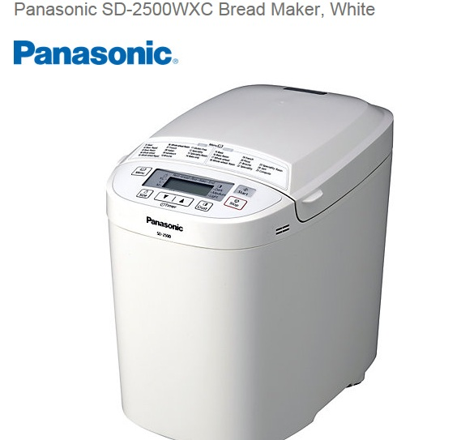
Sale of the Century Wake up to the smell of freshly baked bread in the morning, with the Panasonic SD-2500WXC bread maker.
A Less than £50 B £50 C More than £50

Slide 30
Breadmaker
C £89.50
Losers get 50 pts and are out of the competition.

Slide 31
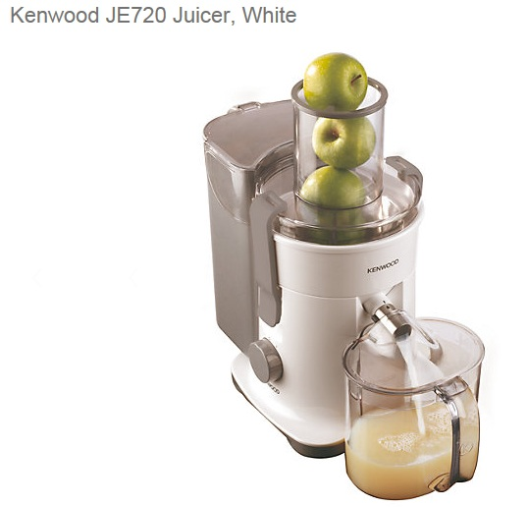
Sale of the Century
The Kenwood JE720 Juicer offers a smarter way to get your five a day. Providing continuous juice, the JE720 features Kenwood’s latest Apex- advanced pulp extraction technology, to give you more juice and less pulp to throw away.
A Less Than £100
B £100
C More than £100

Slide 32
Juicer
A £99.50
Losers get 100 pts and are out of the competition

Slide 33
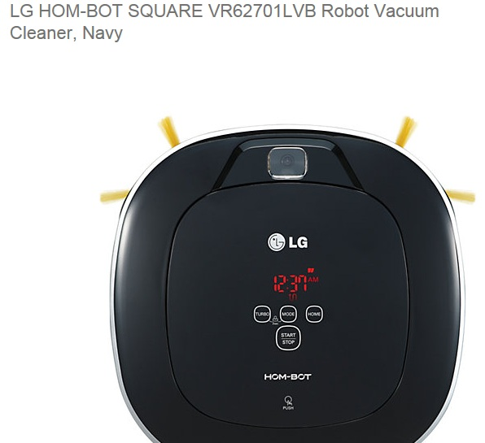
Sale of the Century
LG HOM-BOT VR62701LVB is a robotic vacuum cleaner that offers the ultimate in innovation and stylish design. This unique vacuum includes sensors and brushes that enable it to reach the hard-to-get-to places that conventional cleaners can’t. Ultrasonic and infrared sensors detect obstacles to avoid, while the vacuum’s Dual Eye 2.0™ cameras accurately scan and map rooms, even when the lights are turned off.
A Less than £500
B £500
C More than £500

Slide 34
Vacuum Cleaner
A £479.50
Losers get 200 pts and are out of the competition

Slide 35
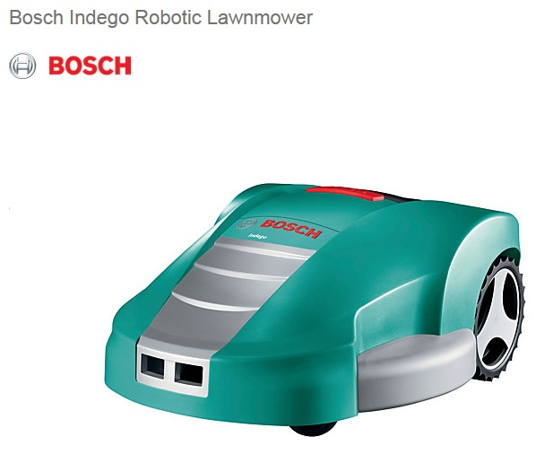
Sale of the Century
The Bosch Indego robotic lawnmower mows all by itself, so you can enjoy other projects in and around your home. Featuring Bosch’s logicut technology, this intelligent navigation system automatically measures your garden, calculates the shortest possible route and gets mowing in orderly parallel lines.
A Less than £1150
B £1150
C More than £1150

Slide 36
Robotic Lawnmower
B £1150
Losers get 300 pts
Winners get 800 pts

Slide 37
Target
You were set a target of 300 points on this round.
How did you do?
The target for the first 3 Rounds was 960 points
Are you meeting the target?

Slide 38
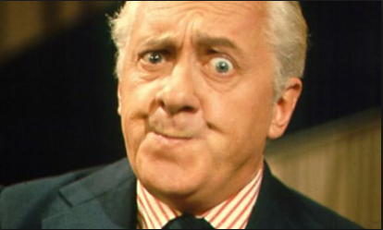
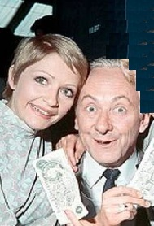
Double Your Money 1955 - 1968
Hughie Green
Monica Rose & Hughie Green

Slide 39
Win from 50 to 6,400 pts
All questions relate to the flags of European nations.
Answer 8 questions correctly to win 6,400
You can quit whenever you like to claim your points before the next question is asked.

Slide 40
Target
Your target is to get the first 4 correct and then quit.
If you did this you would get 400 points, so that is your target.

Slide 41
For 50 points
Whose flag is this?

Slide 42
Switzerland
Double or Quits?

Slide 43
For 100 points
Whose flag is this?

Slide 44
Iceland
Double or Quits?

Slide 45
For 200 points
Whose flag is this?

Slide 46
Belgium
Double or Quits?

Slide 47
For 400 points
Whose flag is this?

Slide 48
Albania
Double or Quits?

Slide 49
For 800 points
Whose flag is this?

Slide 50
Macedonia
Double or Quits?

Slide 51
For 1,600 points
Whose flag is this?

Slide 52
Bosnia
Double or Quits?

Slide 53
For 3,200 points
Whose flag is this?

Slide 54
Estonia
Double or Quits?

Slide 55
For 6,400 points
Whose flag is this?

Slide 56
Lithuania
Did you hit the jackpot?

Slide 57
How did you do?
The target was 400 points. Did you meet the target? Did you avoid going on and getting a loser to wipe out all of your points?
The overall target at the half way point is 1360 points.
Are you meeting the target?

Slide 58
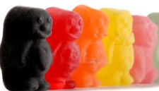
Half way through the show;get another glass of wine!
Lucky

Slide 59
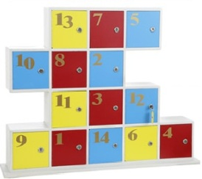
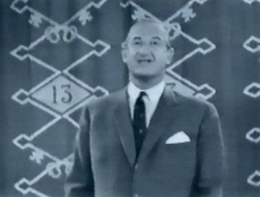
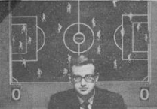
Take Your Pick 1955 - 1968
Michael Miles

Slide 60
Rules
There are 14 boxes with varying points in them. You can choose boxes 1 to 12, or box 14. You cannot choose box 13.
Which Box are you choosing?
Your target is 600 points.

Slide 61
Points available
0 100 200 300
400 500 600 800
1000 1200 1500
1800 2000
A share of Mystery box 13

Slide 62
Box 1
Name a UK county beginning with B

Slide 63
Counties starting B
Bedfordshire
Berkshire
Buckinghamshire

Slide 64
If you chose Box 1
Did you get a correct county?
Would you like to trade your box for a share of box 13?
If not then you are awarded 400 points

Slide 65
Box 2
Name a UK county beginning with C

Slide 66
Counties beginning with C
Cambridge
Cheshire
Cornwall
Cumbria

Slide 67
If you chose Box 2
Did you get a correct county?
Would you like to trade your box for a share of box 13?
If not then you are awarded 800 points

Slide 68
Box 3
Name a UK county beginning with D.

Slide 69
Box 3
Counties starting with D.
Derbyshire
Devon
Dorset
Durham

Slide 70
If you chose Box 3
Did you get a correct county?
Would you like to trade your box for a share of box 13?
If not then you are awarded 200 points

Slide 71
Box 4
Name a UK county starting with H

Slide 72
Box 4
Counties starting with H
Hampshire
Herefordshire
Hertfordshire

Slide 73
If you chose Box 4
Did you get a correct county?
Would you like to trade your box for a share of box 13?
If not then you are awarded 1200 points

Slide 74
Box 5
Name a UK county starting with L.

Slide 75
Box 5
Counties starting with L
Lancashire
Leicestershire
Lincolnshire

Slide 76
If you chose Box 5
Did you get a correct county?
Would you like to trade your box for a share of box 13?
If not then you are awarded 100 points

Slide 77
Box 6
Name a UK county starting with N.

Slide 78
Box 6
UK counties starting with N
Norfolk
Northamptonshire
Northumberland
North Yorkshire
Nottinghamshire

Slide 79
If you chose Box 6
Did you get a correct county?
Would you like to trade your box for a share of box 13?
If not then you are awarded 2000 points

Slide 80
Box 7
Name a UK county starting with O

Slide 81
Box 7
UK county starting with O
Oxfordshire

Slide 82
If you chose Box 7
Did you get a correct county?
Would you like to trade your box for a share of box 13?
If not then you are awarded 1000 points

Slide 83
Box 8
Name a UK county starting with S

Slide 84
Box 8
Counties starting with S
Salop
Shropshire
Somerset
South Yorkshire
Suffolk
Staffordshire
Surrey
Sussex

Slide 85
If you chose Box 8
Did you get a correct county?
Would you like to trade your box for a share of box 13?
If not then you are awarded 0 points

Slide 86
Box 9
Name a UK county starting with W

Slide 87
Box 9
Counties starting with W
Warwickshire
West Midlands
West Sussex
West Yorkshire
Wiltshire
Worcestershire

Slide 88
If you chose Box 9
Did you get a correct county?
Would you like to trade your box for a share of box 13?
If not then you are awarded 1500 points

Slide 89
Box 10
Name a UK county starting with A or E

Slide 90
Box 10
Counties starting with A or E
Avon
Essex
East Sussex

Slide 91
If you chose Box 10
Did you get a correct county?
Would you like to trade your box for a share of box 13?
If not then you are awarded 500 points

Slide 92
Box 11
Name a UK County starting with M

Slide 93
Box 11
Counties starting with M
Merseyside
Middlesex

Slide 94
If you chose Box 11
Did you get a correct county?
Would you like to trade your box for a share of box 13?
If not then you are awarded 1800 points

Slide 95
Box 12
Name a UK County starting with G

Slide 96
Box 12
Counties starting with G
Gloucestershire
Greater London
Greater Manchester

Slide 97
If you chose Box 12
Did you get a correct county?
Would you like to trade your box for a share of box 13?
If not then you are awarded 300 points

Slide 98
Box 14
Name a UK County starting with I,K or R

Slide 99
Box 14
Counties starting with I,K or R
Isle of Wight
Kent
Rutland

Slide 100
If you chose Box 14
Did you get a correct county?
Would you like to trade your box for a share of box 13?
If not then you are awarded 600 points

Slide 101
Box 13
So you decided to opt for a share of Box 13 instead of opening your box did you?

Slide 102
Box 13
5 other people also opted for Box 13, so you get a 1/6th share of the box
This mystery box contains 4800 points
So you get 800 points

Slide 103
How are you doing?
Your target on this round was to get 600 points.
How well did you do?
Your target on all 5 rounds to date is 1960 points.
Are you meeting this target?

Slide 104
Generation Game 1971-1982 & 1990 - 2002

Slide 105
Rules
In this round you must try to remember the 20 items and how many of each there are.
You get 25 points for each you remember and a bonus 25 points if you correctly state how many there are.
Your target is to remember 14 of them and to correctly remember the numbers in 10 of those 14.
This gives you a target of 24x25 = 600 points

Slide 106
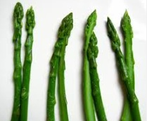
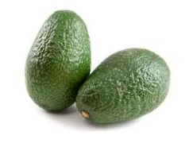
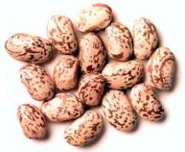
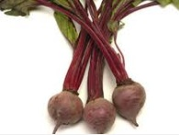
Generation Game Conveyor belt 25 points per item+ Bonuses
Asparagus | Avocados | Beans | Beet

Slide 107
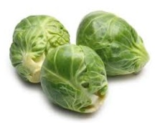
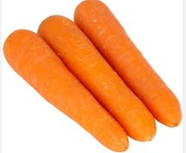
Generation Game Conveyor belt
Brussels | Carrots | Corn

Slide 108
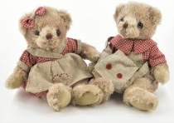
Generation Game Conveyor Belt
Cuddly Toys

Slide 109
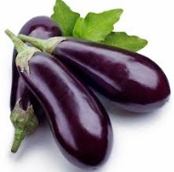
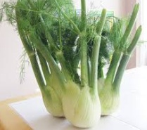
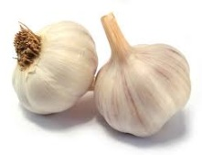
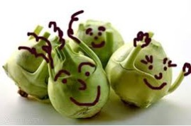
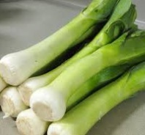
Generation Game Conveyor Belt
Eggplants | Fennel | Garlic
Kohlrabi | Leek | Lettuce

Slide 110
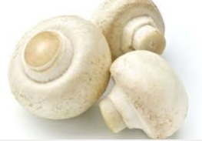
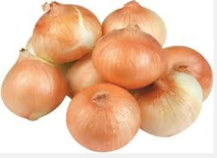
Generation Game Conveyor Belt
Mushroom | Onion

Slide 111
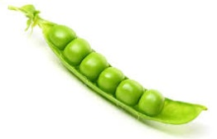
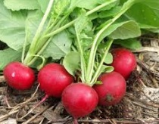
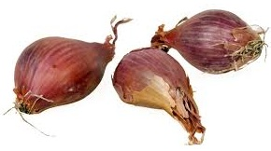
Generation Game Conveyor Belt
Parsnip | Peas
Radish | Shallots

Slide 112
Generation Game
Let the thinking commence.
No cheating, just write down as many of the items as you can remember and the number of each item.

Slide 113
Generation Game Conveyor Belt 25 pts each item (25 pt bonus for correct number)
Asparagus | 8 | Garlic | 2
Avocados | 2 | Kohlrabi | 4
Beans | 16 | Leeks | 6
Beet | 3 | Lettuce | 2
Brussels | 3 | Mushroom | 3
Carrots | 3 | Onions | 8
Corn | 1 | Parsnip | 8
Cuddly Toys | 2 | Peas | 6
Eggplants | 3 | Radish | 5
Fennel | 3 | Shallot | 3

Slide 114
How well did you do?
Did you meet the target of 600 points?
The overall target has now reached 2560 points.
Are you meeting this target?

Slide 115
Pointless 24th August 2009 - present

Slide 116
Word Round
Think of a word in the Oxford English Dictionary ending in
OND
The longer, more obscure your word the more points you will score.
Points from 1 to 500 are available.

Slide 117
What is your word?
Your target is to get 140 points on this round.

Slide 118
The Junior Board
ABSCOND | 100 | DISPOND | 50 | LOND | 100
ALMOND | 50 | FISHPOND | 100 | MILLPOND | 100
ARCSECOND | 150 | FOND | 10 | MUISHOND | 300
AYOND | 100 | FROND | 20 | NURSEPOND | 200
BACKBOND | 100 | GERLOND | 150 | OVERFOND | 150
BEYOND | 20 | GIRLOND | 150 | POND | 10
BLOND | 10 | GOND | 100 | RESPOND | 50
BOND | 10 | GROND | 100 | RICHMOND | 150
BROND | 100 | HOND | 100 | SECOND | 20
COND | 100 | HORSEPOND | 100 | STOND | 100
DESPOND | 50 | KEESHOND | 300 | STROND | 100
DIAMOND | 150 | KHOND | 250 | YOND | 100

Slide 119
And the big boys board!!!
VAGABOND | 350 | MILLISECOND | 400
CORRESPOND | 350 | FEMTOSECOND | 500
ATTOSECOND | 350 | PICOSECOND | 500
ALLHALLOND | 350 | MICROSECOND | 400
TESTICOND | 350 | NANOSECOND | 450

Slide 120
How did you do?
What did your word score?
Did you beat the target of 140 points?
The overall target in the first 7 rounds is 2700 points.
Are you meeting this target?

Slide 121
Winner Takes All 1975 – 1988

Slide 122
Rules
There are now just 7 questions to go.
In this Round you will be asked a question and given 5 possible answers.
You must choose just one of the answers.
You must decide how many of your points you would like to gamble on your answer/
If you are correct you make that number of points profit. If you are wrong you lose that number of points.
Turn your points into at least 10,000 to win the show.

Slide 123
7) How many English/British Monarchs have been named William, Henry, Edward, George or Richard since 1066? (After Edward the Confessor and not counting Richard Cromwell)
A | 26
B | 27
C | 28
D | 29
E | 30

Slide 124
How many English/British Monarchs have been named William, Henry, Edward, George or Richard since 1066? (After Edward the Confessor and not counting Richard Cromwell)
A | 26
B | 27
C | 28
D | 29
E | 30
William 4 Henry 8 Edward 8 George 6 Richard 3

Slide 125
6) What is the TOTAL number of letters in these Shakespeare plays beginning with M?
M……. FOR ……..E
M…….. OF .……E
M….. ….. OF ………R
M…… ….. ……..M
M…… … .… …….G
A | 87
B | 88
C | 89
D | 90
E | None of these

Slide 126
What is the TOTAL number of letters in these Shakespeare plays beginning with M?
MEASURE FOR MEASURE (17)
MERCHANT OF VENICE (16)
MERRY WIVES OF WINDSOR (19)
MIDSUMMER NIGHTS DREAM (20)
MUCH ADO ABOUT NOTHING (19)
A | 87
B | 88
C | 89
D | 90
E | None of these (91)

Slide 127
5) Which of the following countries has 3 capital cities?
A | Bolivia
B | Ivory Coast
C | Nigeria
D | South Africa
E | Tanzania

Slide 128
Which of the following countries has 3 capital cities?
A | Bolivia (La Paz & Sucre)
B | Ivory Coast (Abidjan & Yamoussoukro)
C | Nigeria (Abuja & Lagos)
D | South Africa (Bloemfontein, Cape Town, Pretoria)
E | Tanzania (Dar Es Salaam & Dodoma)

Slide 129
4) At 6’s and 7’s How many of the following are correct references to ‘at sixes and sevens’? 1. An early French 2 dice game called Hazard because 6 and 7 are the most difficult numbers to get. 2.Chaucer ‘set the world on 6 or 7’ meaning to risk ones life. 3.In 1484 the Merchant Taylors and Skinners trading companies had their argument settled by agreeing to give dinner to the other on the 6th and 7th Feast days. 4.In the early 1960s Harold Macmillan was in a quandary as to whether to join the EEC 6 or the EFTA 7. (European Economic Community/European Free Trade Assoc)
A | 0
B | 1
C | 2
D | 3
E | 4

Slide 130
At 6’s and 7’s How many of the following are correct references to ‘at sixes and sevens’? 1. An early French 2 dice game called Hazard because 6 and 7 are the most difficult numbers to get. 2.Chaucer ‘set the world on 6 or 7’ meaning to risk ones life. 3.In 1484 the Merchant Taylors and Skinners trading companies had their argument settled by agreeing to give dinner to the other on the 6th and 7th Feast days. 4.In the early 1960s Harold Macmillan was in a quandary as to whether to join the EEC 6 or the EFTA 7. (European Economic Community/European Free Trade Assoc)
A | 0
B | 1
C | 2
D | 3
E | 4

Slide 131
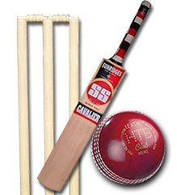
3) How many of the 18 First Class Cricket counties are Shire counties?
A | 7
B | 8
C | 9
D | 10
E | 11

Slide 132
How many of the 18 First Class Cricket counties are Shire counties?
A | 7
B | 8
C | 9
D | 10
E | 11
Derbyshire, Gloucestershire, Hampshire, Lancashire, Leicestershire, Northamptonshire, Nottinghamshire, Warwickshire, Worcestershire, Yorkshire

Slide 133
2) Which university won the first University Challenge title in 1963?
A | Balliol College Oxford
B | Keele University
C | Leicester University
D | Magdalen College Oxford
E | New College Oxford

Slide 134
Which university won the first University Challenge title in 1963?
A | Balliol College Oxford
B | Keele University
C | Leicester University
D | Magdalen College Oxford
E | New College Oxford

Slide 135
1) If the politicians below were listed in age order, who would be in the middle?
A | David Miliband
B | Ed Miliband
C | Nick Clegg
D | George Osborne
E | David Cameron

Slide 136
If the Politicians listed below were placed in age order, who would be in the middle?
A | David Miliband 15/7/1965
B | Ed Miliband 24/12/1969
C | Nick Clegg 7/1/1967
D | George Osborne 23/5/1971
E | David Cameron 9/10/1966

Slide 137
That’s all folks
Did you manage to beat the target of 10,000 points?
If so, well done!
If not, then why not try some of the other quizzes on this website?

